Slide 1
Classification Methods
Classification­ Basic Concepts
Classification­ Two step process
Example of Classification
Decision tree Induction
Attribute selection Measures

Slide 2
Classification –Basic Concepts
Classification:
Classification is a form of data analysis task where a model or classifier is constructed to predict class labels.
loan application data : “safe” or “risky” and Marketing data yes” or “no” Labels are categorical and represented as discrete values and unordered. Analysis provide better understanding of the data at large.
Classification is a two step process
Learning step ­ Building of classification model based on training data
Classification step­ If the model’s accuracy is acceptable, use the model to classify the test data.
•
•
•
•
•
•

Slide 3
Classification—A Two-Step Process
•
Data classification is a two step process consisting of Learning and Classification step
Learning step: The classification algorithm built a classifier by analyzing or “learning from” a training set.
Training set made of database tuples and their associated class label.
Tuple X is represented by n dimensional vector n (x1,x2,x3,x4...xn) depicting n measurements.
Each X belong to a predefined class and the class label attribute is discrete­valued and unordered.
The individual tuples making up the training set are referred to as
training tuples
•
•
•
•
•

Slide 4
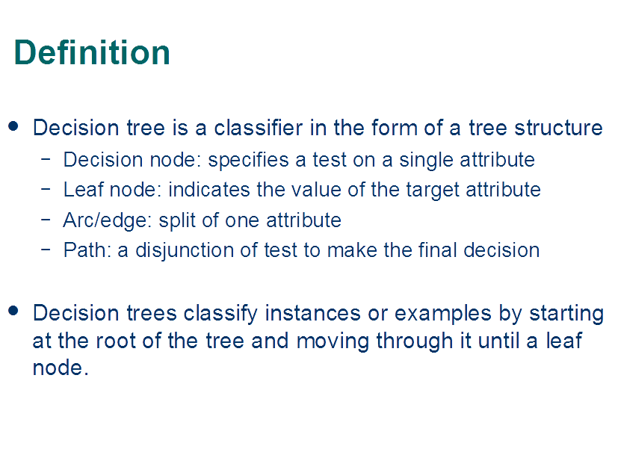
Classification—A Two-Step Process

Slide 5
Decision Tree Induction
•
Decision tree induction is the learning of decision trees from class
labelled training tuples.
Decision tree algorithm known as ID3 Decision tree is a flowchart­like structure ,
age?
•
•
<=30
overc
ast
>40
–
–
–
Internal node=> test on an attribu
Branch=> outcome of the test
te
31..40
Leaf node=> holds the class labe
student?
yes
credit rating?
l
●
Eg: a decision tree for concept
no
yes
excellent fair
buys_computer, internal node
reprsents a test on attribute
no
yes
no
yes
and each leaf node reprsents a class

Slide 6
Algorithm for Decision Tree Induction
•
How are decision trees used for classification?
Given a tuple X for which the associated class label is unknown
The attribute values of the tuple are tested against the decision tree
A path is traced from the root to the leaf node which holds the class prediction of X
Decision trees are easily converted to classification rules.
Why decision trees?
●
●
Does not require domain knowledge
Handles multidimensional data
Learning and classification steps are simple and fast Easy to understand and attains good accuracy
●
●
●

Slide 7
Decision Tree Induction
Basic algorithm (a greedy algorithm)
Tree is constructed in a top­down recursive divide­and­conquer manner
Starts with a training set of tuples and their associated class labels.
Training set is recursively partitioned into smaller subsets as the tree is being built.
Attribute selection measures are used to select the attribute that best partitions the tuples into distinct classes.
The tree nodes are created and the partition is labeled with the splitting criterion, branches are grown out for each outcome of the criteria
•

Slide 8
Attribute Selection Measures
•
Attribute selection measure is a heuristic for selecting the splitting criterion that best separates a given data partition data D of training tuples into individual classes.
Attribute selection measure are called as “splitting rules” because they determine how the tuples at a given node are to be split.
Three popular attribute selection measures are:
Information gain
Gain Ratio
Gini Index
•
•

Slide 9
Attribute Selection Measure: Information Gain (ID3/C4.5)
❑
❑
Select the attribute with the highest information gain
Let p_{i} be the probability that an arbitrary tuple in D belongs to class C_{i}, estimated by |C_{i, D}|/|D|
Expected information (entropy) needed to classify a tuple in D:
m
❑
Info( D )=−∑ p_{i} log₂ ( p_{i} )
i=1
Partition the tuples in D on some attribute A having v distinct
values {a1,a2,a3..av} observed from the training set.
Attribute A can be used to split D into v partitions and the partitions corresponds to the branches of the node N
Information needed to do exact classification :
v
❑
❑
❑
∑
|D |
Gain( A )=Info ( D )− Info _{A} ( D )
Info ( D )=
j
× Info( D )
A
_{j= 1} | D|
j
❑
Information gain is defined as the difference between orginal and
new requirement
Gain( A )=
Info ( D)−Info ( D )
Gain( A )=Info ( D )− Info ( D )
A
A

Slide 10
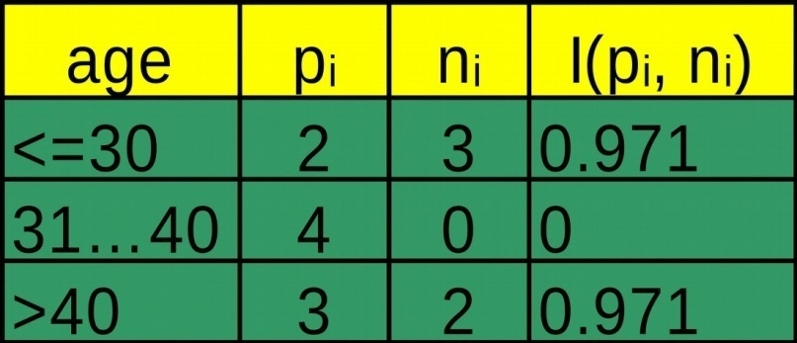
Attribute Selection: Information Gain

Class P: buys_computer = “yes”
5 4
Info_{age} ( D )=₁₄ I ( 2,3 )+ ₁₄ I ( 4,0)
5

Class N: buys_computer = “no”
Info ( D )=I ( 9,5 )=− ⁹ log ( ⁹ )− ⁵ log ( ⁵ )=0 . 940
+ I ( 3,2)=0 . 694
2 2
14 14 14 14
14
⁵ I (2,3 )
means “age <=30”
14
has 5 out of 14 samples,
with 2 yes’es and 3 no’s. Hence
age | income | student | credit_rating | buys_computer
<=30 | high | no | fair | no
<=30 | high | no | excellent | no
31…40 | high | no | fair | yes
>40 | medium | no | fair | yes
>40 | low | yes | fair | yes
>40 | low | yes | excellent | no
31…40 | low | yes | excellent | yes
<=30 | medium | no | fair | no
<=30 | low | yes | fair | yes
>40 | medium | yes | fair | yes
<=30 | medium | yes | excellent | yes
31…40 | medium | no | excellent | yes
31…40 | high | yes | fair | yes
>40 | medium | no | excellent | no
Gain(age )=Info( D )−Info ( D)=0 . 246
age
Similarly:
Gain( income )=0 . 029
Gain( student )=0 . 151
Gain( credit_{rating} )= 0 . 048
16

Slide 11
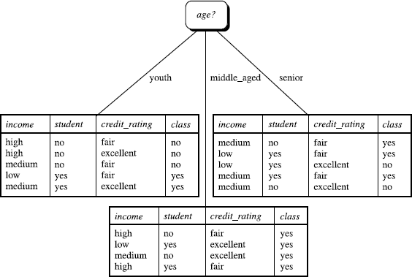
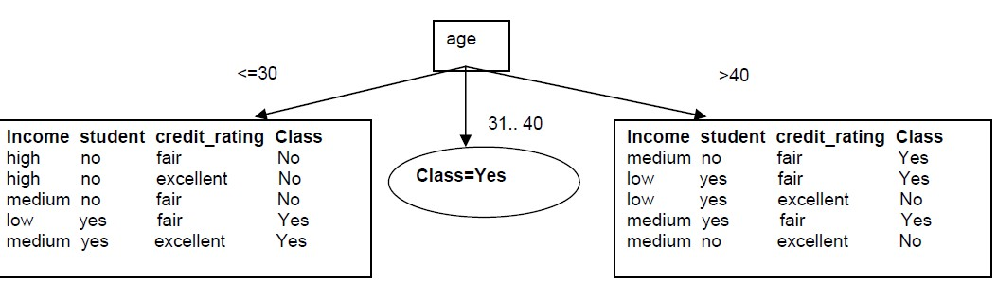
Attribute selection-Information gain

Slide 12
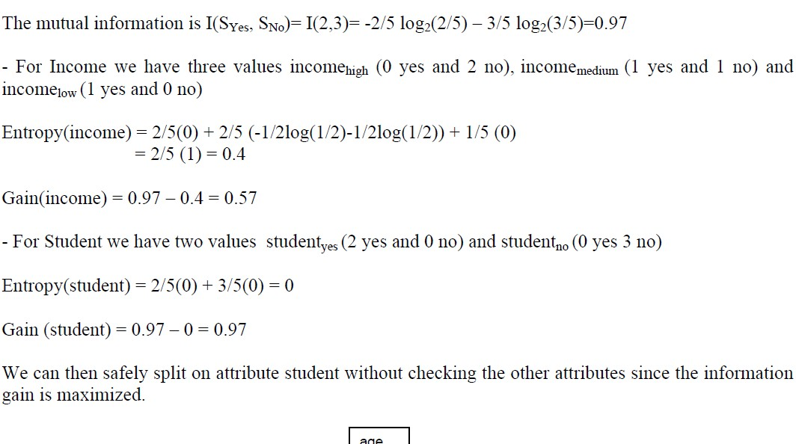
Attribute Selection: Information Gain

Slide 13
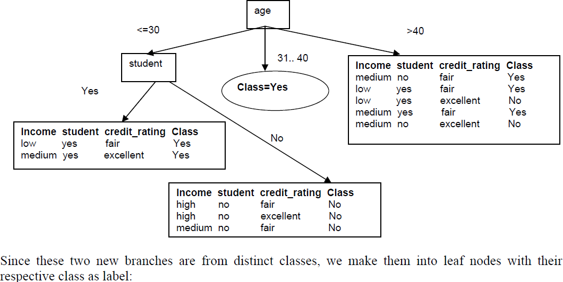
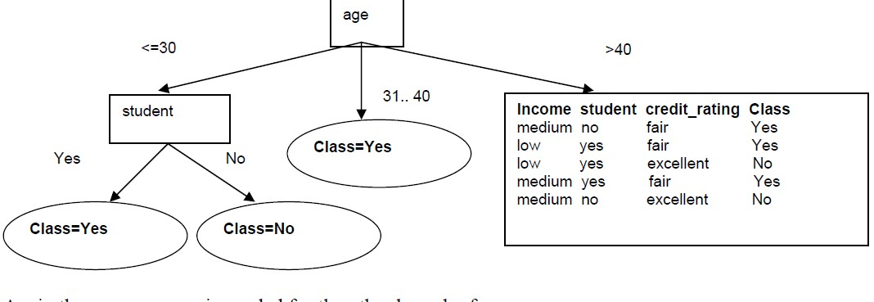
Attribute Selection: Information Gain

Slide 14
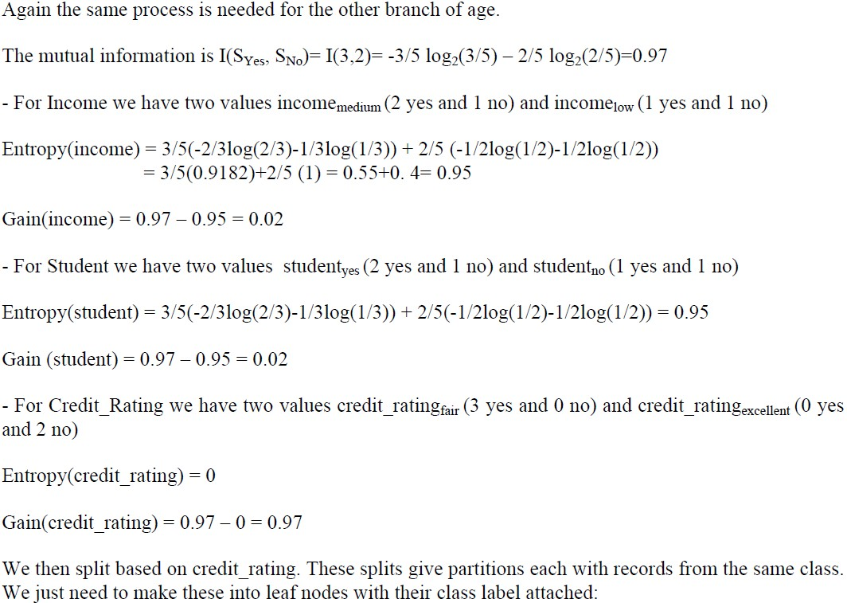
Attribute Selection: Information Gain

Slide 15
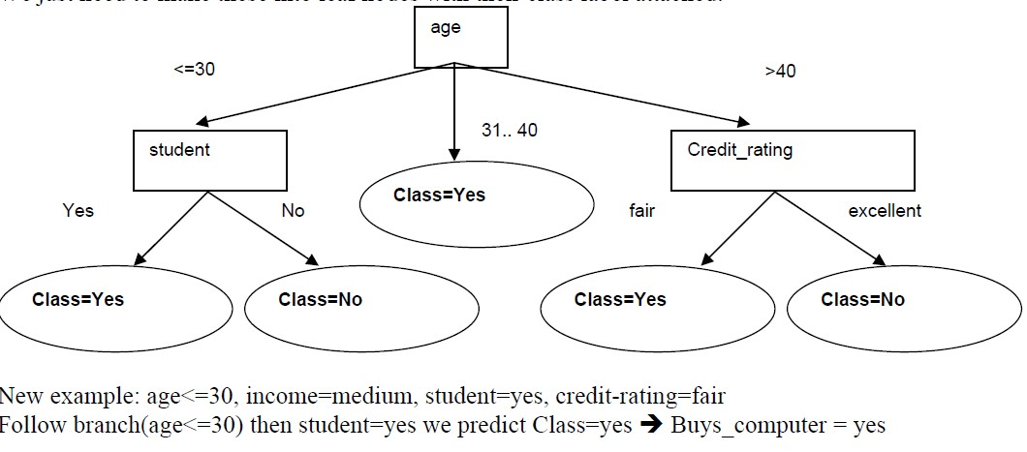
Output

Slide 16
Computing Information-Gain for Continuous-Valued Attributes
•
•
Let attribute A be a continuous-valued attribute Must determine the best split point for A
– Sort the value A in increasing order
Typically, the midpoint between each pair of adjacent values is considered as a possible split point
(a_{i}+a_{i+1})/2 is the midpoint between the values of a_{i} and ªi+1
The point with the minimum expected information requirement for A is selected as the split-point for A
Split:
D1 is the set of tuples in D satisfying A ≤ split-point, and D2 is the set of tuples in D satisfying A > split-point
•
22

Slide 17
Algorithm for Decision Tree Induction
•
Algorithm is called with three parameters D, attribute_list and attribute_selection_method
D=>complete set of training tuples and associated class labels attribute_list => list of attribute describing the tuples. attribute_selection_method:
heuristics procedure to determine the splitting criterion.
Determines which attribute to test at node N by determining the “best” way to separate the tuples D into classes
Determines which branch to grow from node N w.r to outcome of the chosen test.
Attribute selection measure: Information gain and Gini index
•
•
•
•

Slide 18
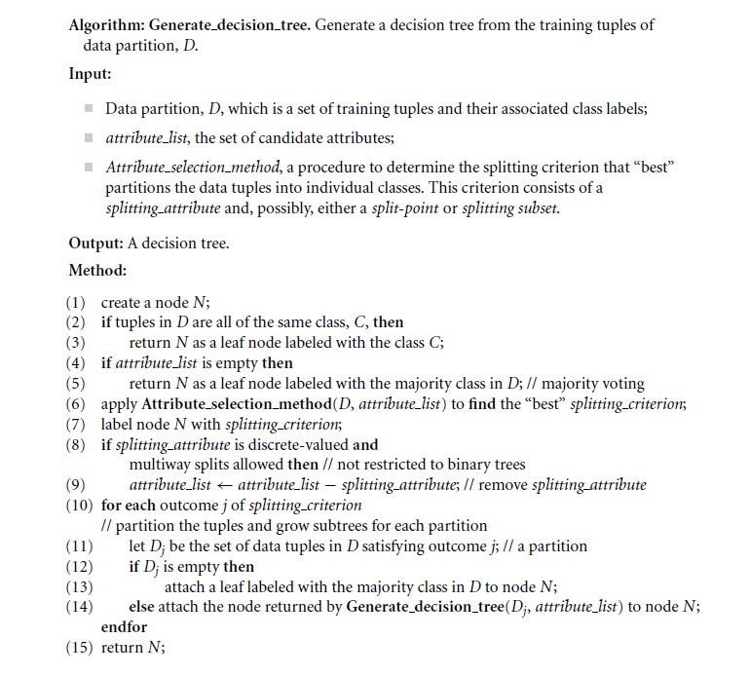
Generation of Decision Tree

Slide 19
Algorithm for Decision Tree Induction
Conditions for stopping partitioning
All samples for a given node belong to the same class
There are no remaining attributes for further partitioning
—majority voting is employed for classifying the leaf
There are no samples left
•

Slide 20
Gain Ratio for Attribute Selection (C4.5)
•
Information gain measure is biased towards attributes with a large number of values
C4.5 (a successor of ID3) uses gain ratio to overcome the problem (normalization to information gain)
•
v
|D _{j}| |D _{j}|
SplitInfo ( D )=−
∑
×log ( )
A
2
| D| |D|
j= 1
– GainRatio(A) = Gain(A)/SplitInfo(A)
– gain_ratio(income) = 0.029/1.557 = 0.019
The attribute with the maximum gain ratio is selected as the splitting attribute
26
•

Slide 21
Gini Index (CART, IBM IntelligentMiner)
•
If a data set D contains examples from n classes, gini index,
gini(D) is defined as
n
gini( D )=1−
∑
p
2
j
j=1
where p_{j} is the probability that a tuple in D belongs to class Ci
If a data set D is split on A into two subsets D₁ and D₂, the
gini index gini(D) is defined as
|D | |D |
gini ( D )=
1 2
gini( D )+ gini ( D )
A
|D| |D|
1 2
•
The subset with minimum gini index is selected as splitting subset
Reduction in Impurity:
•
Δgini ( A )=gini ( D )−gini_{A} ( D )
27

Slide 22
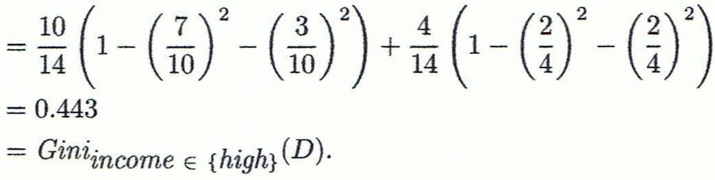
Computation of Gini Index
•
Ex. D has 9 tuples in buys_computer = “yes” and 5 in “no”
( ) ( )
9
2 2
5
gini( D )=1− ₁₄
=0 . 459
⁻ 14
•
Suppose the attribute income partitions D into 10 in D₁: {low,
medium} and 4 in D₂
( ) ( )
10 4
14
gini ( D)=
Gini ( D )+ Gini ( D )
{ }
1 2
income∈ low,medium
14
Gini_{{low,high}} is 0.458; Gini_{{medium,high}} is 0.450.
Thus, split
on the {low,medium} (and {high}) since it has the lowest
Gini index
28

Slide 23
Comparing Attribute Selection Measures
The three measures, in general, return good results but
Information gain:
biased towards multivalued attributes
Gain ratio:
tends to prefer unbalanced splits in which one partition is much smaller than the others
Gini index:
biased to multivalued attributes
has difficulty when # of classes is large
tends to favor tests that result in equal-sized partitions and purity in both partitions
29

Slide 24
Overfitting and Tree Pruning
•
Overfitting: An induced tree may overfit the training data
Too many branches, some may reflect anomalies due to noise or outliers
Poor accuracy for unseen samples
•
Two approaches to avoid overfitting
Prepruning: Halt tree construction early ̵ do not split a node if this would result in the goodness measure falling below a threshold (Difficult to choose best threshold)
Postpruning: Remove branches from a “fully grown” tree— get a sequence of progressively pruned trees
Use a set of data different from the training data to decide which is the “best pruned tree”

Slide 25
Classification in Large Databases
•
Classification—a classical problem extensively studied by statisticians and machine learning researchers
•
Scalability: Classifying data sets with millions of examples and hundreds of attributes with reasonable speed
•
Why is decision tree induction popular?
relatively faster learning speed (than other classification methods)
convertible to simple and easy to understand classification rules
can use SQL queries for accessing databases
comparable classification accuracy with other methods

